Slide 1


What is Economics all about?

Slide 2














Different Definitions Of Economics
WEALTH DEFINITION
WELFARE DEFINITION SCARCITY DEFINITION
GROWTH DEFINITION

Slide 3


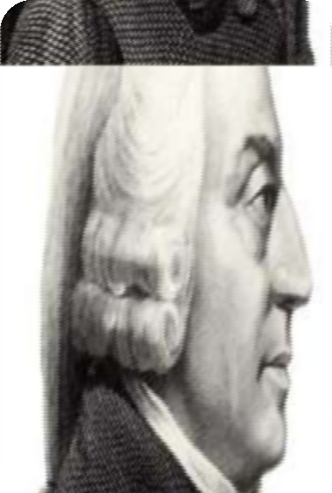
Adam Smith (1723-1790)
“An Enquiry Into Nature & Causes Of The Wealth Of Nations” (1776)
Emphasis on Wealth, Invisible hand and laissez-faire economy.
“Economics is an enquiry
into the nature and causes
of wealth of nations”

Slide 4
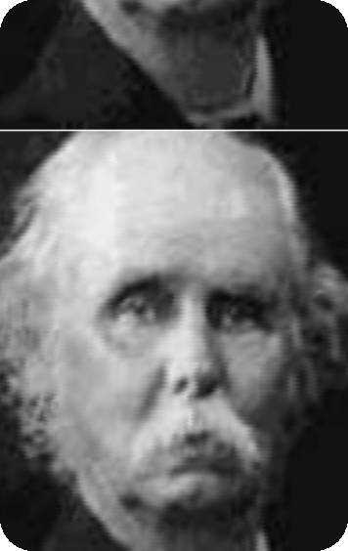
Alfred Marshall(1842-1924)
‘Principles Of Economics’(1890) Welfare, Social Man, Classificatory
“Economics is the study of ordinary business of life; it examines the part of indivisual and social action which is most closely connected with the attainment and with use of material requisites of well being”

Slide 5
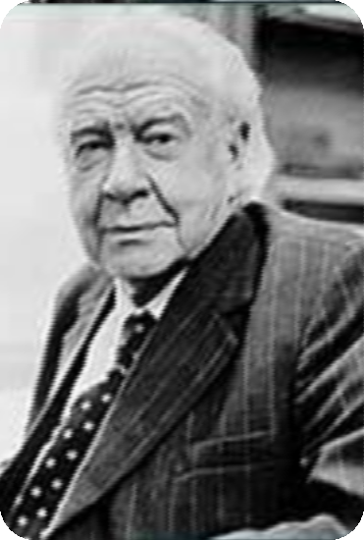
Lionel Robbins(1898-1984)
‘An Essay On Nature & Significance Of Economic Science’(1932)
Scarcity, Unlimited Wants, Analytical
“Economics is a science that studies human behaviour as a relationship between ends and scarce means which have
alternative uses”

Slide 6

Paul A. Samuelson(1915-2009)
“Economics: An Introductory Analysis”(1948)
Economic Resources, Full utilization of resources
Economics is the study of how people and society end up choosing with or without the use of money, to employ scarce productive resources that could have alternative uses, it produces various commodities over time & distributes them for consumption, now or in the future, among various persons & groups in society. It analyses costs & benefits of improving patterns of resource allocation’

Slide 7

“Managerial economics is concerned with the application of economic concepts and economic tools to problems of formulating rational decision making”
Edwin Mansfield

Slide 8
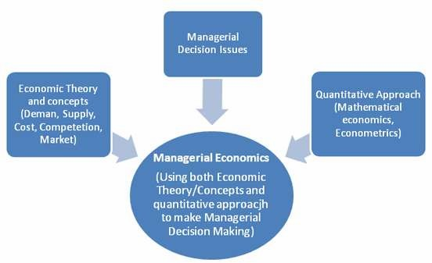
Thank You

